Slide 1

Today’s Topics:
Reasons for Cyber Insurance Coverage
Cyber Policies 101
Calculating Coverage Needs
Navigating the Claims Process
Tapping Carrier Resources
8 Ways to Avoid Trouble

Slide 2

Reasons for Cyber Insurance Coverage
The history and evolution of cyber policies.
Technology presence in business is now ubiquitous.
More threats than ever before.
Notes:
Derek to lead this. Rich weighs in.
Dave come in with the association perspective.
Cover the top areas of exposure currently happening – Ransomware, phishing, etc.
1. Unauthorized access to your systems
2. Data breach
3. Privacy liability - have you violated your policy?
4. Systems failure - act of god
5. Funds transfer fraud - social engineering fraud
Proposed Question: What cyber risks do you see as most pressing for your organization?

Slide 3

Cyber Policies 101
First party coverages versus third party coverages.
Breach response costs.
Cyber extortion.
Funds transfer fraud.
Business interruption and extra expense.
Underwriting complexity.
Notes:
Derek & Rich providing the basis for this discussion.
Policy basics.
Walk through first party versus third party coverages and examples of each.
Dave – How is phishing typically covered and how does it interact with other aspects of the policy like the crime policy when it comes to unauthorized funds transfer?
Proposed Question: Has this improved your understanding of the basics of cyber insurance?

Slide 4

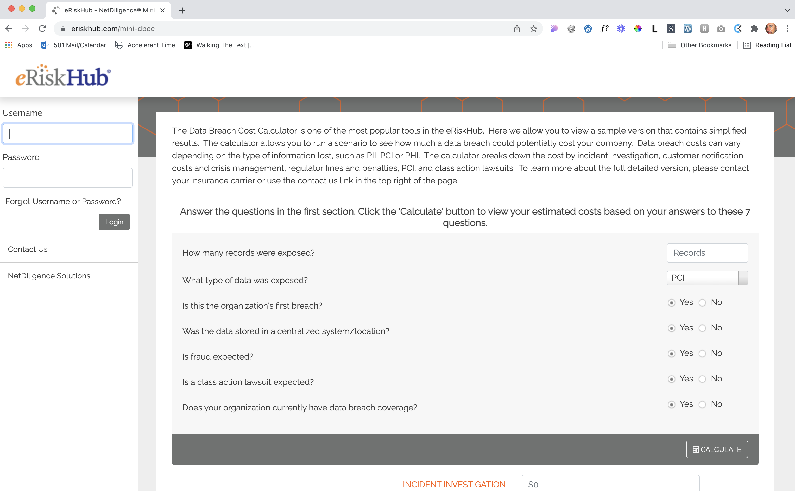
Calculating Coverage Needs
Breach Calculator Tool:
https://eriskhub.com/mini-dbcc
Open-Source mini calculator.
Benchmarking
Notes:
Derek to lead this.
David – weigh in on their journey as limits have increased and the introduction of the Excess Loss policy this year.
Go through the coverage calculator
Biggest lost is ransomware and business interruptions.
Breach Calculator Tool: https://eriskhub.com/mini-dbcc -- Open-Source mini calculator.
More expanded version available to ERisk Hub subscribers
Proposed Question: Will you be evaluating your coverage limits based on our discussion today?

Slide 5

Navigating the Claims Process
Notice to the insurance company.
        DO NOT simply try self resolution.
Initial call with the claim adjuster.
Scoping call.
Forensic kick-off.
Investigation, restoration and negotiation.
Submittal of proof of loss.
Notes:
Rich to lead this.
Recommend reporting FBI – ic3.gov, but there are laws/regs in the works calling for federal disclosure to the government of cyber incidence.
No question on this slide as I expect people to be reticent to discuss claims activity they may have had with this organization.
QUESTION: Have you experienced the need to file a claim in the last 12 months?

Slide 6

Tapping Carrier Resources
Pre-claim services versus post-incident response.
Sample Service Areas
Proactive Vulnerability Scanning
Legal representation
Securing forensic specialists
Digital asset restoration
Notification assistance
Public Relations
Notes:
Rich to lead this.
Dave – Does your policy carrier make resources available?
Derek – What trends have you see with respect to carriers using these vetted resources?
Proposed Question: Do you have incident response plans in place currently as part of your risk mitigation planning?

Slide 7

8 Ways to Avoid Trouble
Create & maintain policies and incident response plans.
Provide security awareness training and phishing testing to all staff.
Add MFA to business systems.
Secure remote desktop protocols.
Patch and validate EVERY system on a monthly basis – OS, AV, AM, software.
Regularly check vendor compliance.
Backup, backup, backup! Test backups regularly.
Audit IT annually – just like your finances.
Notes:
James to cover these.
Dave – How does your organization approach managing these IT risks? Do you audit IT like your financials?
Derek – How do you see these items playing into the renewal process? Start early….
IT is a journey – it is never just a destination.
Proposed Question: How frequently do you audit your IT security policies?

Slide 8

Other Questions?
Notes:
James to cover these.
Dave – How does your organization approach managing these IT risks? Do you audit IT like your financials?
IT is a journey – it is never just a destination.
Proposed Question: How frequently do you?

Slide 9
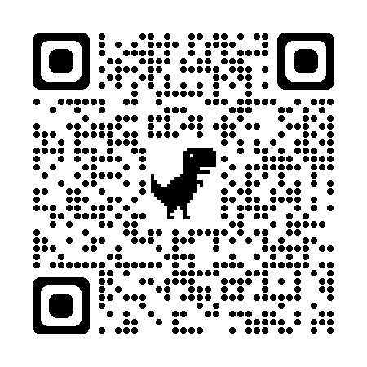
AMS/CRM Software Selection Survey
501Works, in partnership with Branching Knowledge, is inviting association staff, vendors and consultants to participate in a survey whose purpose is to improve this industry's friction-ridden and fractured process for selecting, implementing, and using AMS/CRM solutions.
The goal is to better understand pain points and consequently uncover best practices that would lead to better buying decisions, processes and systems for associations and non-profits.
Participants can also enter a drawing for $50 Amazon gift cards. Results will be published in early 2022. More information about the survey can be found on our website at www.501works.com/research.
Notes:
Add the QR code to this slide…

Slide 10


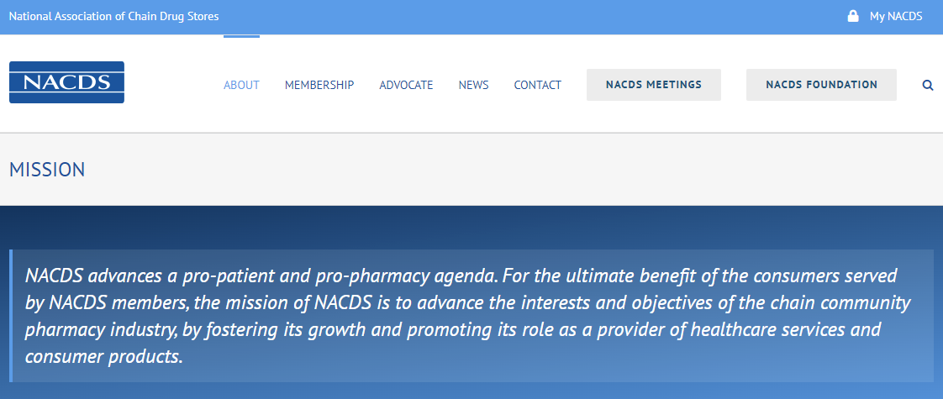

Thank You Dave!
If you have additional questions, please contact Dave Fitzsimmons:

Slide 11


Thank You Derek!
If you have additional questions, please contact Derek Symer:
Derek.Symer@ahtins.com 202.845.8260

Slide 12


Thank You Rich!
If you have additional questions, please contact Rich Gatz:
rich@coalitioninc.com
(630) 445-3187

Slide 13








501Works
PRODUCTS & SERVICES
We are here to help!
Call or email us for a
30 minute free
consulting session
Mojo Middleware™ - Our flagship product to easily integrate association software.
Software Mage™ – a tool that helps you navigate the AMS/CRM selection process, gather requirements, draft your RFP, and evaluate vendor responses.
703-459-9779
marquis@501works.com
• Customized Software Solutions and Integrations
• IT Consulting Services
• Advanced Web Design and Content Solutions
https://501Works.com

